Slide 1
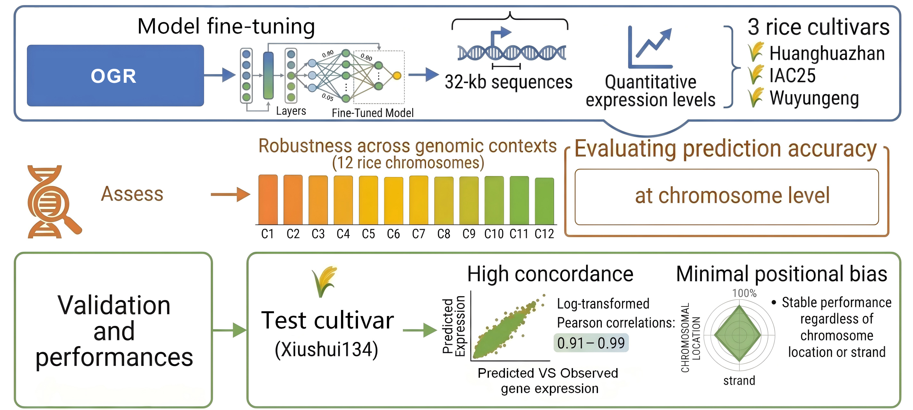
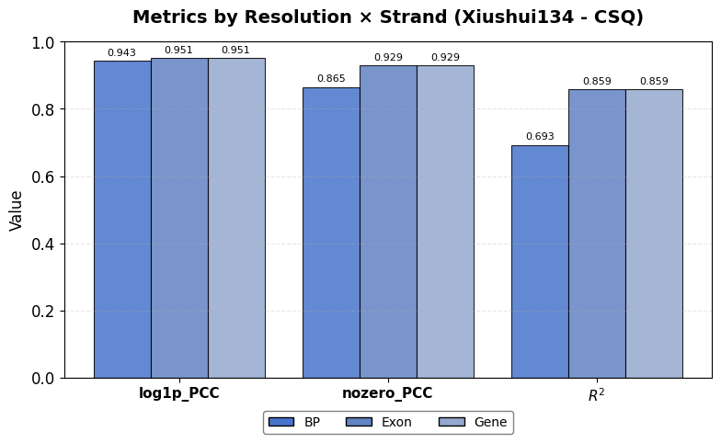
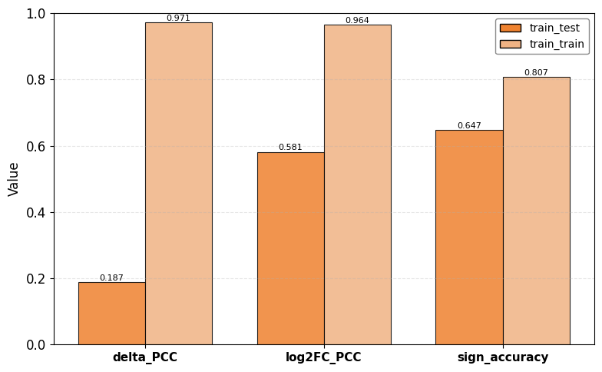
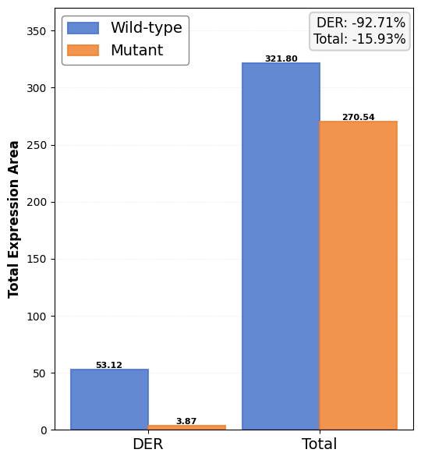
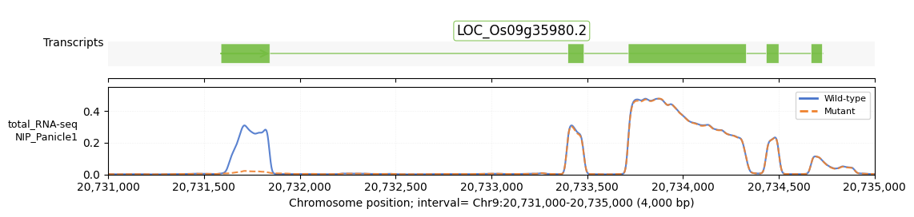
A
B
D
C

Slide 3
(C) Effect of a nucleotide mutation within the TAC1 gene (LOC_Os09g35980) on expression prediction. Predicted expression profiles are compared between the wild-type reference (AGGA; solid blue line) and mutant (GGGA; dashed orange line) sequences. A striking divergence occurs around position 20,732,589, where an aberrant signal peak emerges exclusively in the wild type profile.
(D) A quantitative comparison of the predicted expression between mutant and wild type. The total expression values are plotted for the differential expression region (DER) (left) and the total region of the gene (right).
The model's predicted expression changes were consistent with the known functional impact of a reported 3'-splice site mutation (AGGA→GGGA) in intron 4. This mutation disrupts proper splicing and alters the 3'-UTR structure (Figure 4C), resulting in a dramatic decrease (-92.71%) in the differential expression region (DER) and a corresponding 15.93% down in predicted transcript abundance (Figure 4D), which ultimately leads to the observed decrease in mature tac1 mRNA levels.

